Slide 1
Sample Entropy
Comparison of first 500 ms segment to the following 1500 ms

Slide 2
Sample Entropy
Measure of the randomness of a time series – how often are patterns of successive data points found later in the data?
Is independent of data length(!)
Two parameters:
m = pattern length („embedded dimension“)
Default is m = 2
r = tolerance threshold, how far away two points are allowed to be to still be considered the same
Default is 0.2*std
Is applied to one time-series at a time
Larger values -> more randomness

Slide 3
Analysis steps
Looking at tracking error (traj_y – purs_y)
Z-transform each segment of each trial individually to make stds and means equal
Calculate SampEn for one segment at a time (m = 2, r = 0.2)
Visual inspection of distribution of SampEn values per condition -> first 500 ms is skewed to the left
Perform Wilcoxon Rank Sum Test for significance on two SampEn distributions
Is significant p < 0.0001

Slide 4
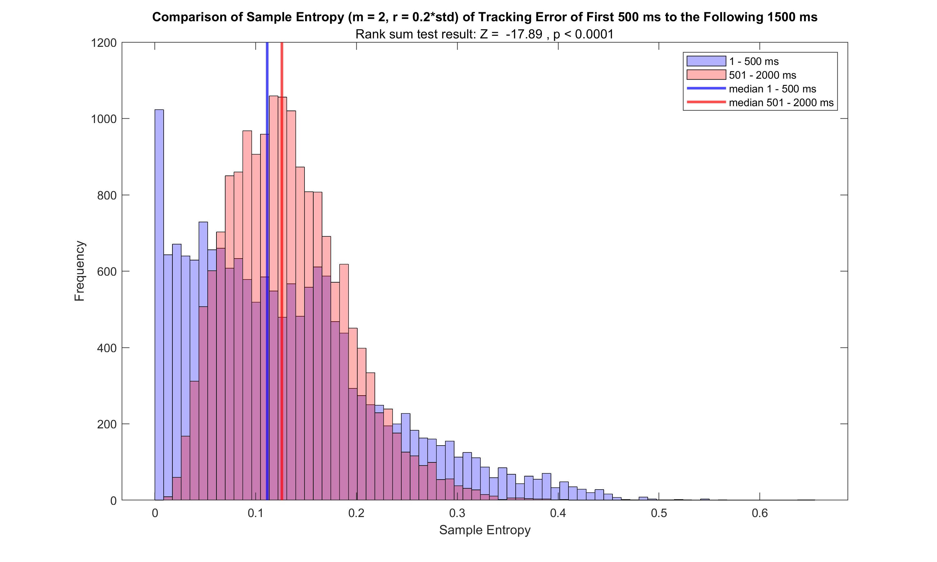

Slide 5
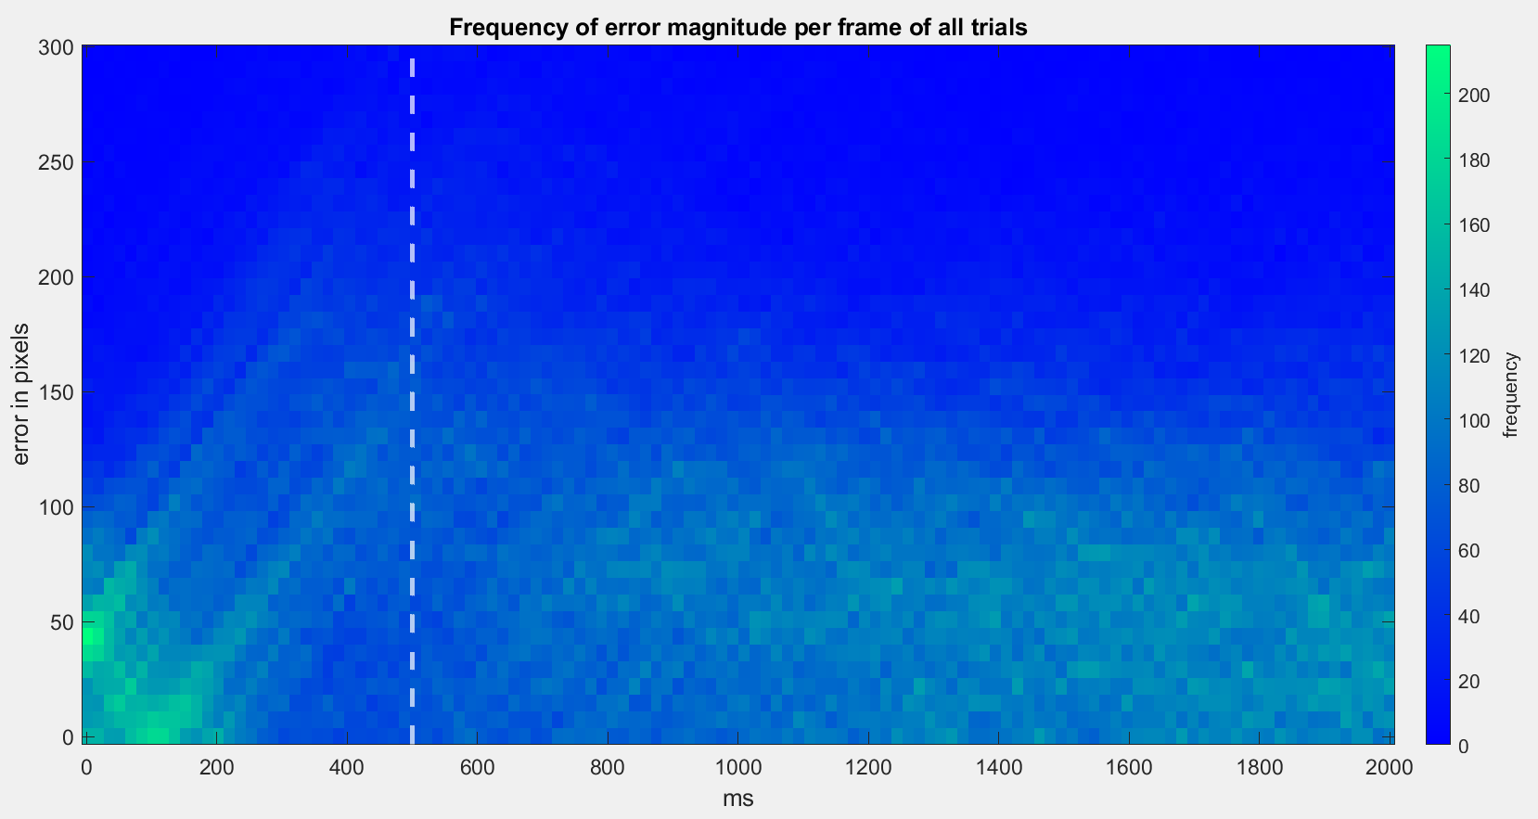
The Heatmap again

